Slide 1
Chapter 9 Relations
9.1 Relations and Their Properties
9.2 n-ary Relations and Their Application
9.3 Representing Relations
9.4 Closures of Relations
9.5 Equivalence Relations
9.6 Partial Orderings

Slide 2
1. Equivalence relations and equivalence classes
【Definition】A relation R on a set A is an equivalence relation if R is
        reflexive
        symmetric
        transitive
For example,
(2) The similarity relation between two triangles
(3) The equivalent relation between two formulas in proposition logic

Slide 3


9.5 Equivalence Relations
Terminologies:
a and b are equivalent
R is an equivalence relation, and (a , b)∈ R
Notation: a ~ b
the equivalence class of x
The set of all elements that are related to an element x of A
Notation:
a representative of the equivalence class

Slide 4









9.5 Equivalence Relations
〖Example 1〗 Congruence Modulo 3
Show that R is an equivalence relation. And find its equivalence classes.
Solution:
reflexive
R is reflexive, since
 symmetric
 transitive

Slide 5
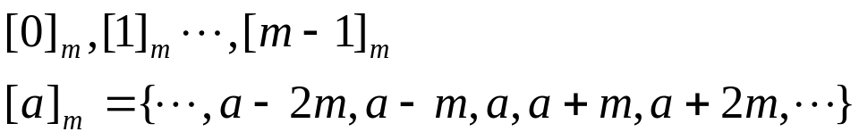
9.5 Equivalence Relations
[0]={…, -6, -3, 0, 3, 6, …}={ 3k | k ∈ Z }
[1]={…, -5, -2, 1, 4, 7, …}={ 3k+1 | k ∈ Z }
[2]={…, -4, -1, 2, 5, 8, …}={ 3k+2 | k ∈ Z }
Congruence Modulo m :
Congruence class Modulo m :

Slide 6

9.5 Equivalence Relations
〖Example 2〗 Suppose that A is a nonempty set, and f is a
function that has A as its domain. Let R be the relation on A
consisting of all ordered pairs (x,y) where f(x)=f(y).
  (1) Show that R is an equivalence relation.
  (2) What are the equivalence classes of R.
Solution:
  (1)
reflexive
 symmetric
 transitive
(2)

Slide 7
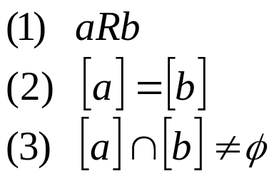




9.5 Equivalence Relations
【 Theorem 1】 Let R be an equivalence relation on a set A.
The following statements are equivalent：
Proof:
Show that (1) implies (2)

Slide 8






9.5 Equivalence Relations
Show that (2) implies (3)
R is reflexive ⇒ [a] is nonempty
Show that (3) implies (1)

Slide 9





9.5 Equivalence Relations
2. Equivalence relations and partitions
【Definition】A partition of set A is a collection of disjoint nonempty subsets of A that have A as their union.
Let be a collection of subsets of A. Then the collection forms a partition of A if and only if
Notation:
A₂
A₁
A₄
A₃
A₅

Slide 10






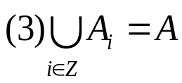

9.5 Equivalence Relations
【 Theorem 2】 Let R be an equivalence relation on a set A.
Then the equivalence classes of R form a partition of A.
Conversely, given a partition of the set A, there is
an equivalence relation R that has the sets ,
as its equivalence classes.
an equivalence relation on a set A ↔ a partition of A
Proof:
the equivalence class of R :

Slide 11


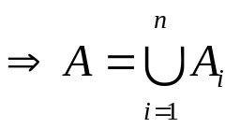









9.5 Equivalence Relations

Slide 12
9.5 Equivalence Relations
〖Example 3〗 Find the partition of the set A from R.
Solution:
4
[0]={0}
[1]={1,2,3}
[4]={4,5}
pr(A)={ [0], [1], [4]}
1
0
3
2
5

Slide 13

9.5 Equivalence Relations
Question:
Congruence Modulo m
Question:
|A|=3. How many different equivalence relations on the set A are there?
Solution:
an equivalence relation on a set A ↔ a partition of A

Slide 14




9.5 Equivalence Relations
3. The operations of equivalence relations
【 Theorem 3】 If are equivalence relations on A, then
is an equivalence relation on A.
Proof:
It suffices to show that the intersection of
  reflexive relations is reflexive,
  symmetric relations is symmetric,
and
  transitive relations is transitive.

Slide 15




9.5 Equivalence Relations
3. The operations of equivalence relations
【 Theorem 3】 If are equivalence relations on A, then
is equivalence relations on A.
Proof:
It suffices to show that the intersection of
  reflexive relations is reflexive,
  symmetric relations is symmetric,
and
  transitive relations is transitive.

Slide 16




9.5 Equivalence Relations
3. The operations of equivalence relations
【 Theorem 3】 If are equivalence relations on A, then
is equivalence relations on A.
Proof:
It suffices to show that the intersection of
  reflexive relations is reflexive,
  symmetric relations is symmetric,
and
  transitive relations is transitive.

Slide 17





9.5 Equivalence Relations
【 Theorem 4】 If are equivalence relations on A, then
is a reflexive and symmetric relation on A.
Proof:
(1) reflexive
(2) symmetric
Question: transitive?

Slide 18
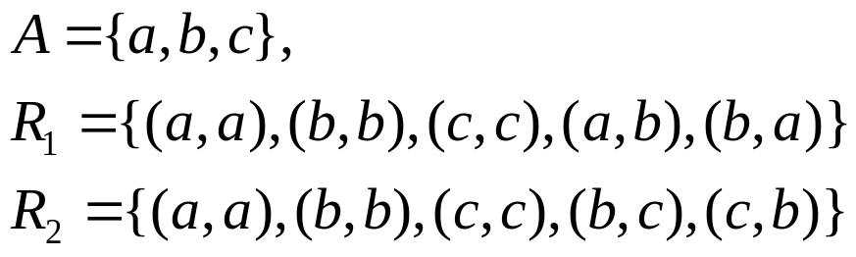

9.5 Equivalence Relations
〖Example 4〗
Is a transitive relation ?
Solution:

Slide 19

9.5 Equivalence Relations
【 Theorem 】 If are equivalence relations on A, then
is an equivalence relation on A.
Proof:
(1) reflexive
(2) symmetric
(3) transitive

Slide 20
Homework: (Due on May 25)
Ver. 8 & Ver. 7
Sec. 9.5 3, 10, 16, 36(b), 39, 41

